Slide 1
Person Search in Videos with One Portrait Through Visual and Temporal Links
Qingqiu Huang, Wentao Liu, and Dahua Lin
CUHK-SenseTime Joint Lab, The Chinese University of Hong Kong Department of Computer Science and Technology, Tsinghua University
ECCV 2018
陈泽宁
18210240003

Slide 2
Introduction

Slide 3
Applications
Searching persons in videos
Police search a wanted criminal
Find the movie shots featured by a popular star

Slide 4
Feature
Searching persons in videos
1.From multiple surveillance cameras, with just a single portrait
2. Environment: pose, makeups, clothing, illumination…

Slide 5
Contribution
Person search in videos
often arises in real-world practice, but remains widely open in research.
Framework
incorporates both the visual similarity and the identity invariance along a tracklet

Slide 6
Contribution
Progressive Propagation via Competitive Consensus
performs the propagation prudently, spreading a piece of identity information only when there is high certainty
Cast Search in Movies (CSM)
contains 127K tracklets of 1218 cast identities from 192 movies.

Slide 7
Related Work

Slide 8
Related Work
Person Re-id
Person Recognition in Photo Album
Person Search

Slide 9
Person Re-id
Aim: Match pedestrian images(or tracklets) from different cameras within a short period.
- Many datasets support the research of re-id.
- The videos are captured by just several cameras in nearby locations within a short period.

Slide 10
Person Re-id - difference
Although the feature learning methods of re-id can be adopted for the Person Search with One Portrait problem, they are substantially different as the query and the gallery would have
huge visual appearances gap
in person search, which would make one-to-one matching fail.

Slide 11
Person Recognition in Photo Album
Aim: Recognize the identities of the queries given a set of labeled persons in gallery.
Difference: the samples of the same identities in query and gallery are still similar in visual appearances and the methods mostly focus on recognizing by visual cues and context

Slide 12
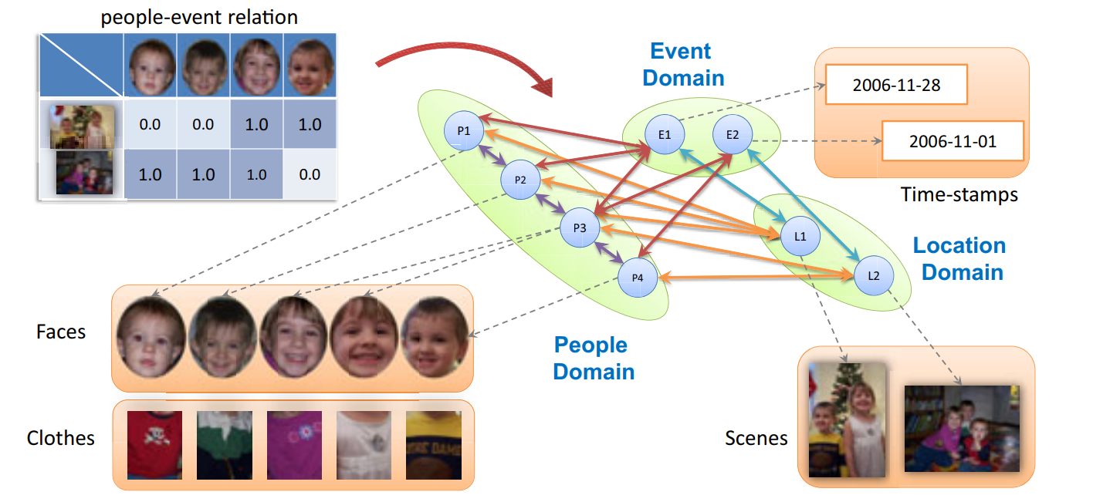
Person Recognition in Photo Album

Slide 13
Person Search
Others work:
- Xiao proposed a person search task which aims to search the corresponding instances in the images of the gallery without bounding box annotation.

Slide 14
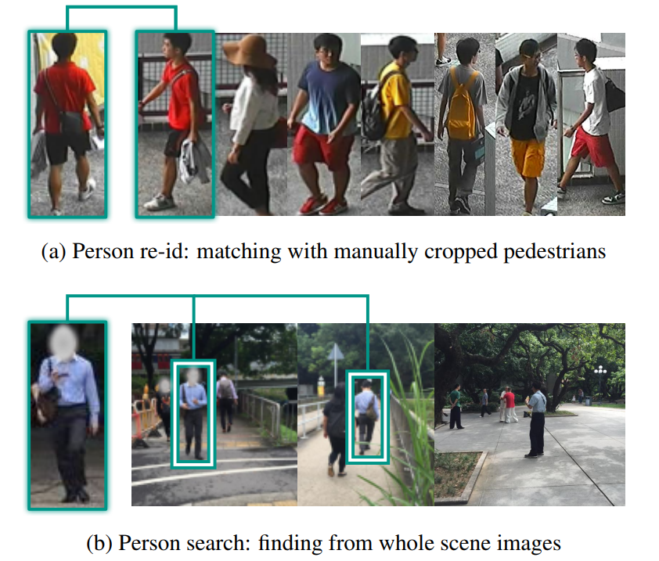
Person Search

Slide 15
CSM

Slide 16
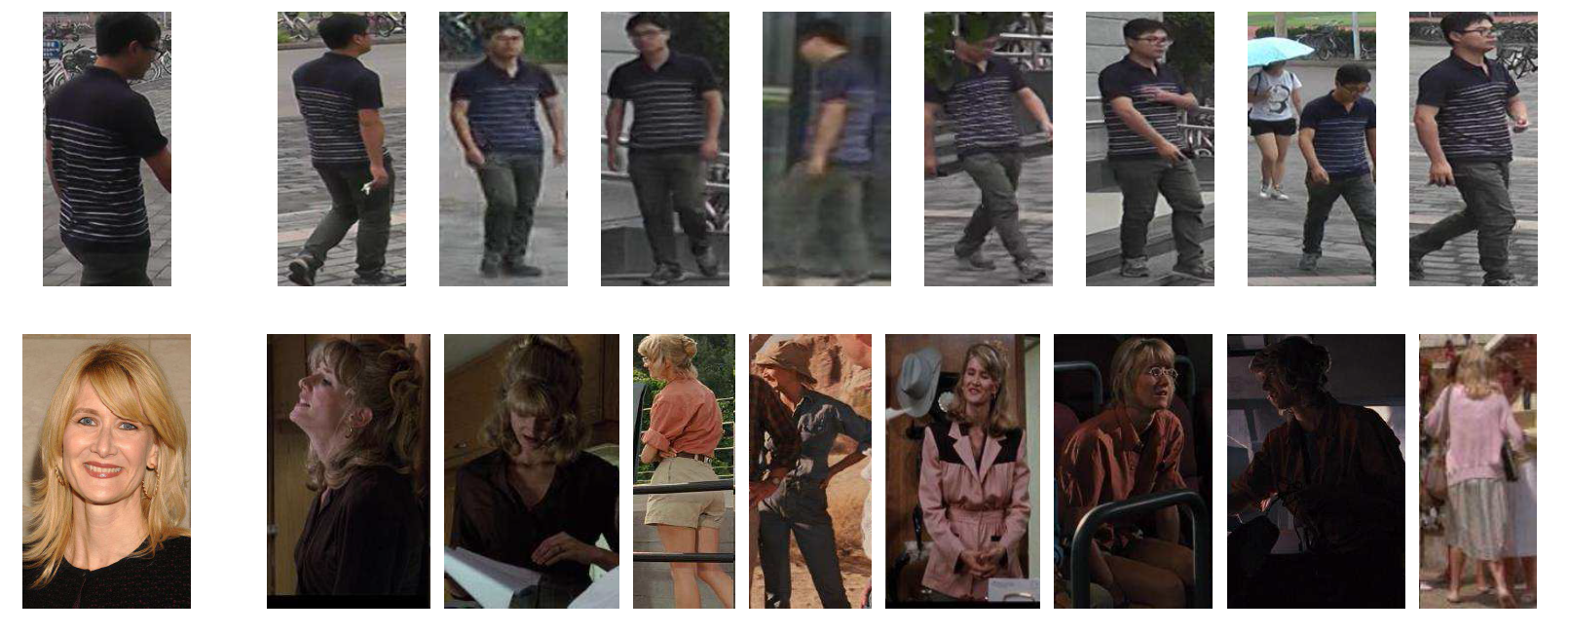
CSM overview
MARS:
CSM:

Slide 17
CSM - Query set
Acquire the cast list from IMDB
More than 10 cast keep 10 according to the order
1218 cast——credited cast
Download a portrait from IMDB/TMDB
Serve as query portraits
Notes:
获取主要演员

Slide 18
CSM – Gallery set
Detecting shots
- Detect the shot boundaries using a fast shot segment technique
- 200K shots of all movies
- selected 3 frames as keyframes

Slide 19
CSM – Gallery set
2. Annotating bounding boxes on keyframes
- manually annotated the person bounding boxes on keyframes
- 700K bounding boxes

Slide 20
CSM – Gallery set
3. Training a person detector
- trained with the annotated bounding boxes
- partition keyframes into training set and testing set by 7:3
- finetuned a Faster-RCNN and pre-trained on MSCOCO
- detector gets around 91%mAP

Slide 21
CSM – Gallery set
4. Generating tracklets
- perform per-frame person detection over all frames
- concatenate the bounding boxes across frames with IoU>0.7 within each shot
- 127K tracklets from 192 movies
Notes:
第四部就是通过刚才的检测器对所有帧进行处理，然后选取每个镜头里帧间IoU大于0.7的那些帧连起来生成短视频，这样就得到了12.7万短视频

Slide 22
CSM – Gallery set
5. Annotating identities
- annotated the identities of all the tracklets
- each tracklet is annotated as one of the credited cast or as “others”
- being labeled as “others” means that the tracklet does not belong to any credited cast of the corresponding movie

Slide 23
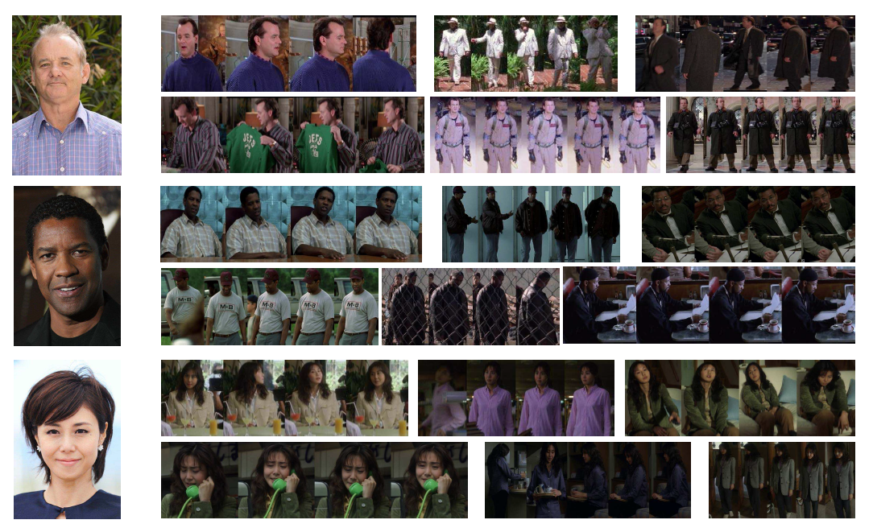
CSM Details
One-portrait Search in Videos

Slide 24
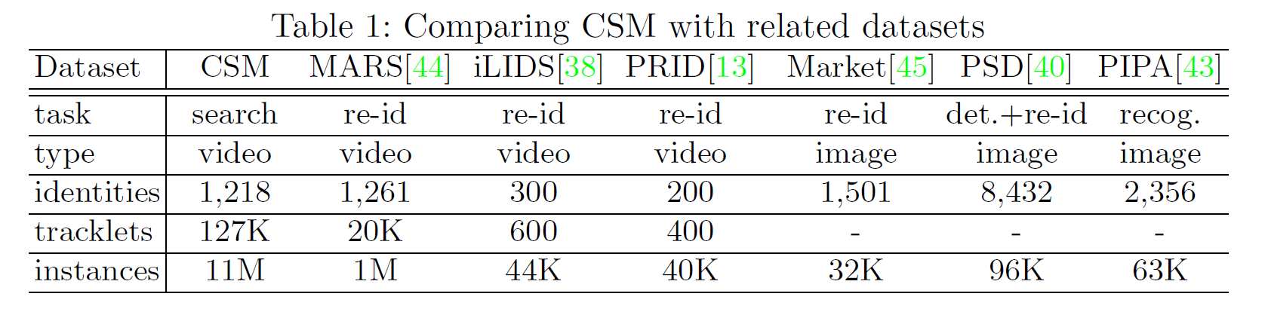
CSM – Compare

Slide 25
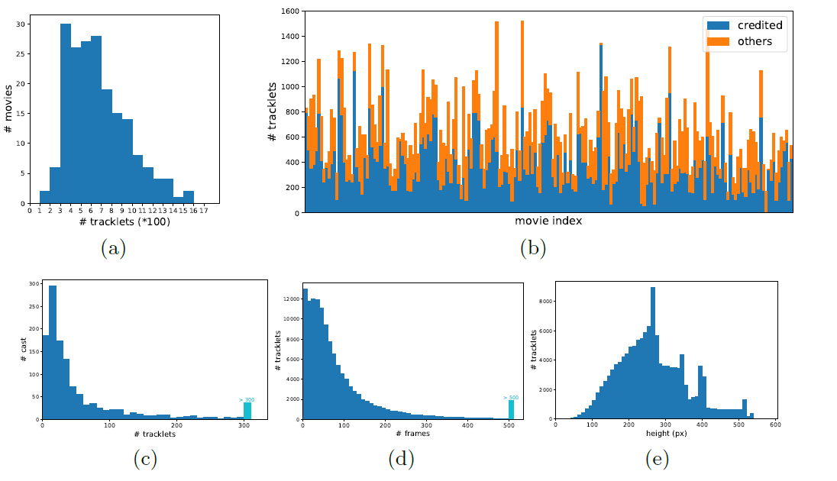
CSM Details

Slide 26
Methodology

Slide 27
Methodology
In this work, we aim to develop a method to find all the occurrences of a person in a long video
e.g. a movie, with just a single portrait. The challenge of this task lies in the vast gap of visual appearance between the portrait (query) and the candidates in the gallery.

Slide 28
Methodology
leveraging the inherent identity invariance along a person tracklet and propagate the identities among instances via both visual and temporal links
The visual and temporal links are complementary. The use of both types of links allows identities to be propagated much further than using either type alone.

Slide 29
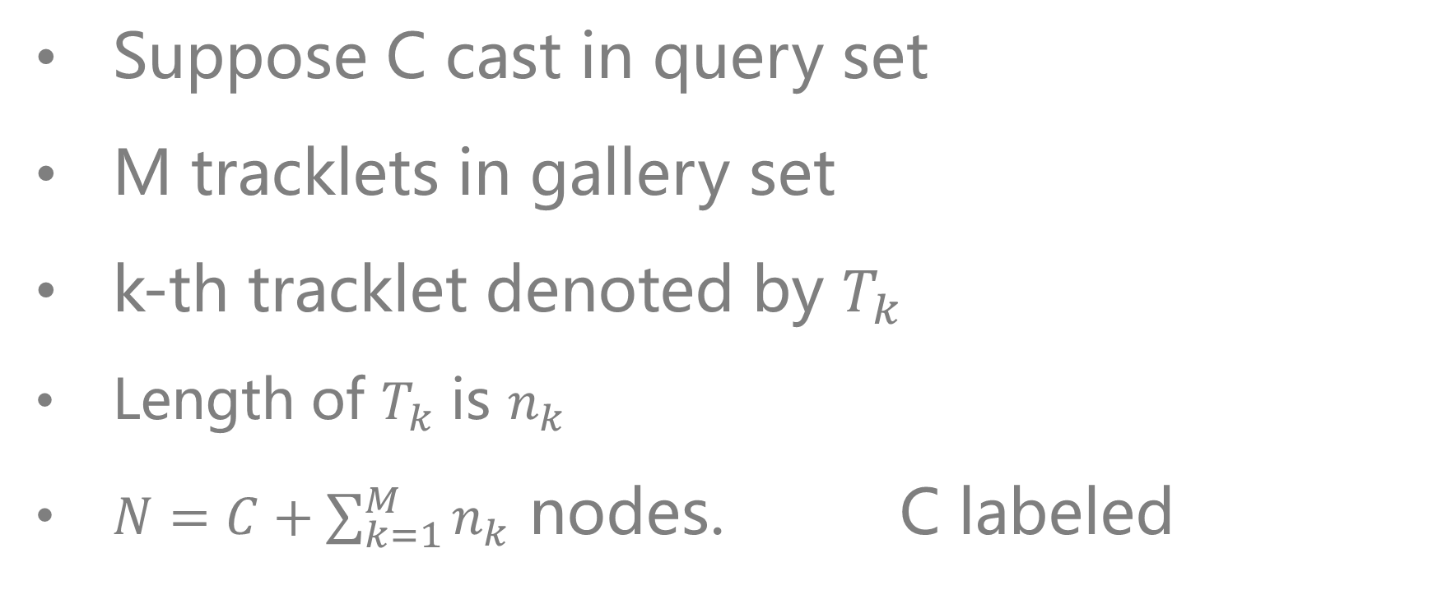
Graph Formulation
Suppose C cast in query set
M tracklets in gallery set
k-th tracklet denoted by $T_{k}$
Length of $T_{k}$ is $n_{k}$
$N=C+\sum_{k=1}^{M}{n_{k}}$ nodes. C labeled

Slide 30
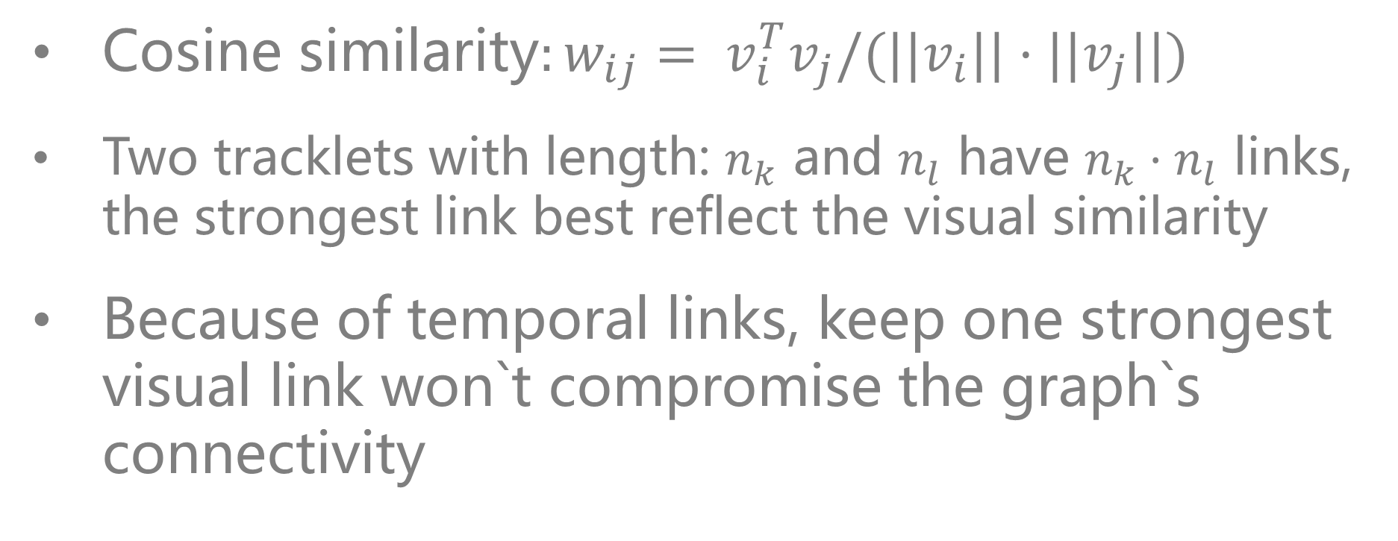
Graph Formulation
Cosine similarity$:w_{ij}= v_{i}^{T}v_{j}/(||v_{i}||·||v_{j}||)$
Two tracklets with length: $n_{k}$ and $n_{l}$ have $n_{k}·n_{l}$ links, the strongest link best reflect the visual similarity
Because of temporal links, keep one strongest visual link won`t compromise the graph`s connectivity

Slide 31
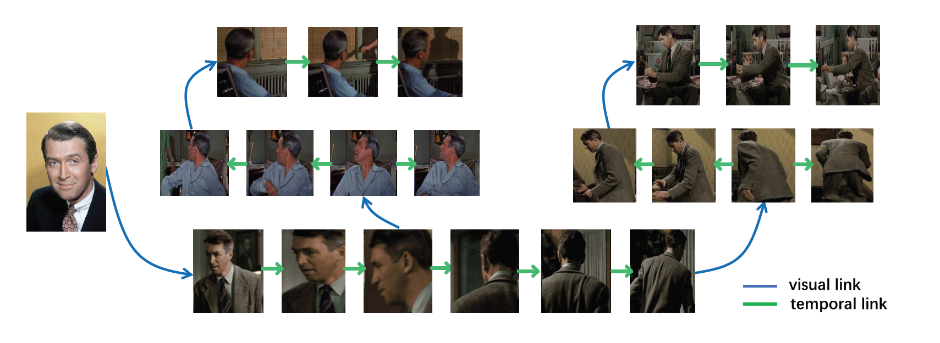
Framework

Slide 32
Propagating via Competitive Consensus

Slide 33
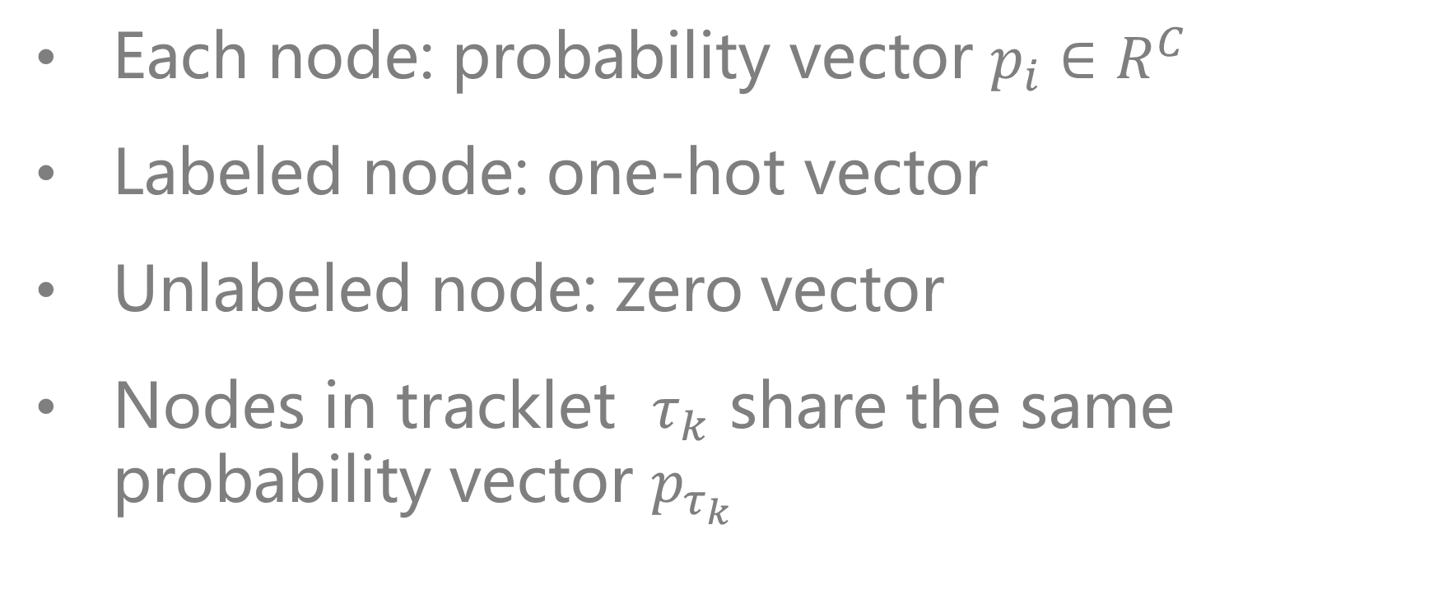
Propagating via Competitive Consensus
Each node: probability vector $p_{i}∈R^{C}$
Labeled node: one-hot vector
Unlabeled node: zero vector
Nodes in tracklet $τ_{k}$ share the same probability vector $p_{τ_{k}}$

Slide 34
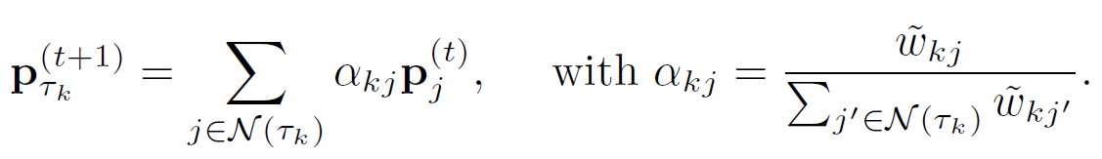
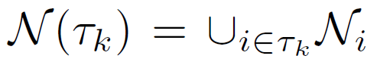
Linear Diffusion
Update vector by taking a linear combination from the neighbors

Slide 35
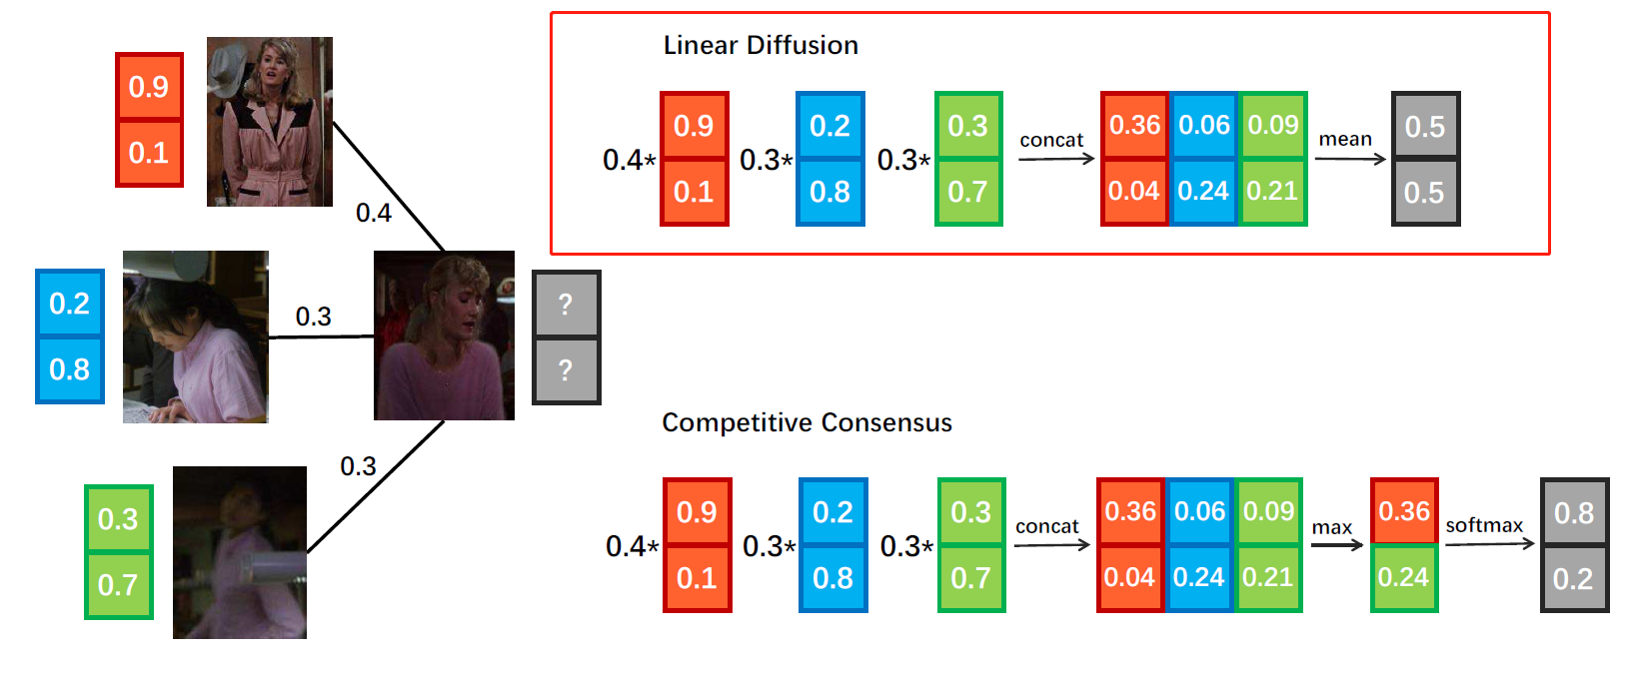
Linear Diffusion

Slide 36
Linear Diffusion
The linear diffusion scheme yields poor performance, even far worse than the naive visual matching method.
Errors will be mixed into the updated probability vector and then propagated to other nodes, especially in a real-world dataset that is filled with noise and challenging cases.

Slide 37
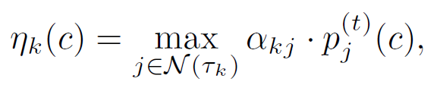
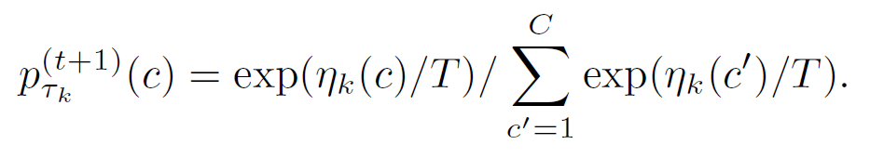
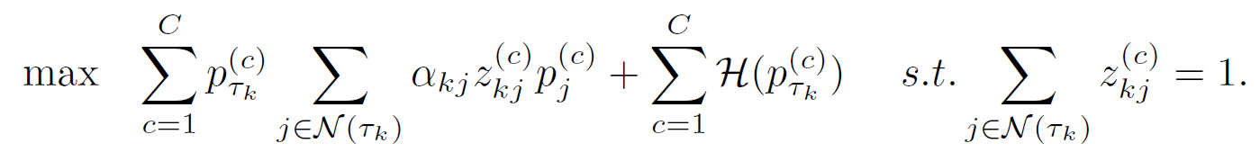
Propagating via Competitive Consensus
Identity:
Tempered softmax:
Solve:

Slide 38
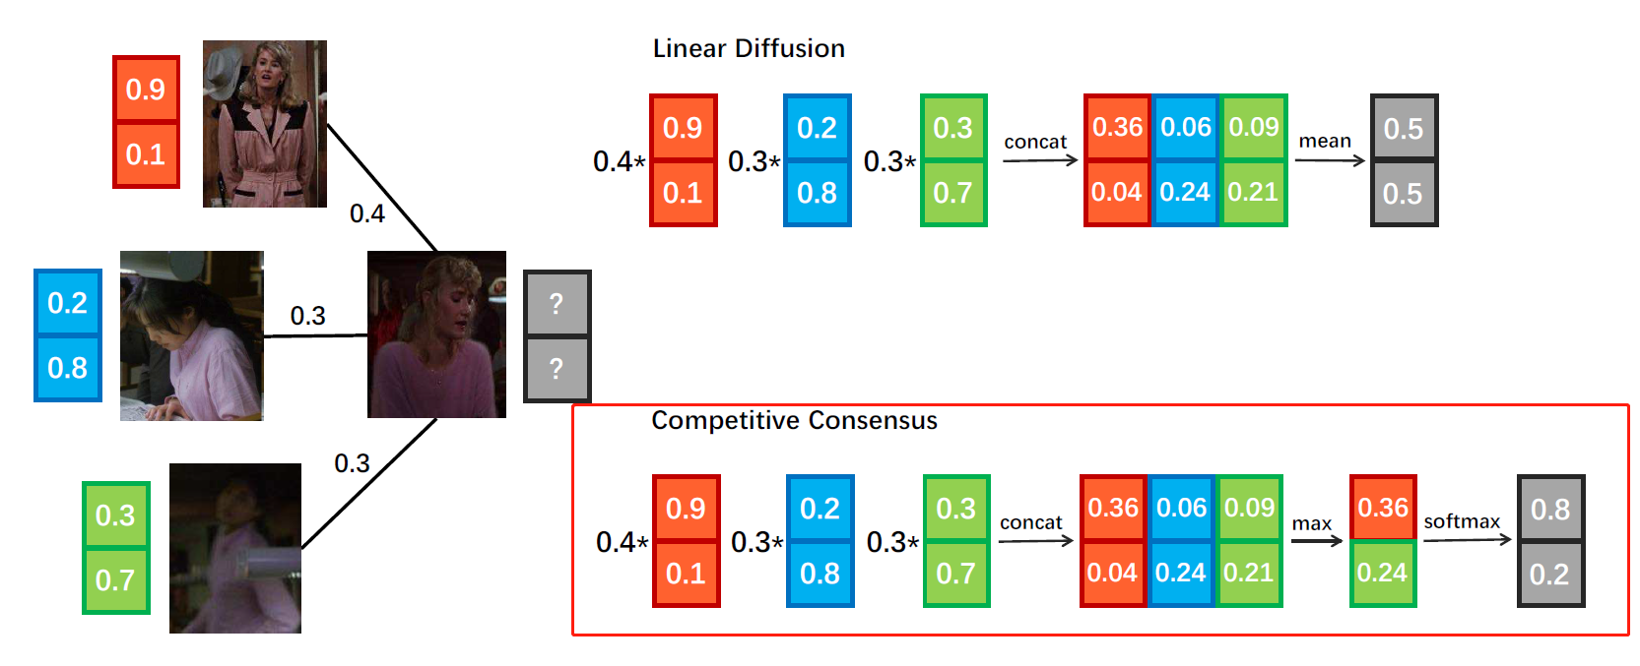
Propagating via Competitive Consensus

Slide 39
Progressive Propagation

Slide 40
Progressive Propagation
Update all labels until convergence is expensive when graph contains a large number of nodes
Unnecessary when we are very confident about the identity of a certain instance for person search

Slide 41
Progressive Propagation
At each iteration, freeze labels with highest confidence.
Empirically, adding 10% of the instances to the label-frozen set in each iteration

Slide 42
Experiments

Slide 43
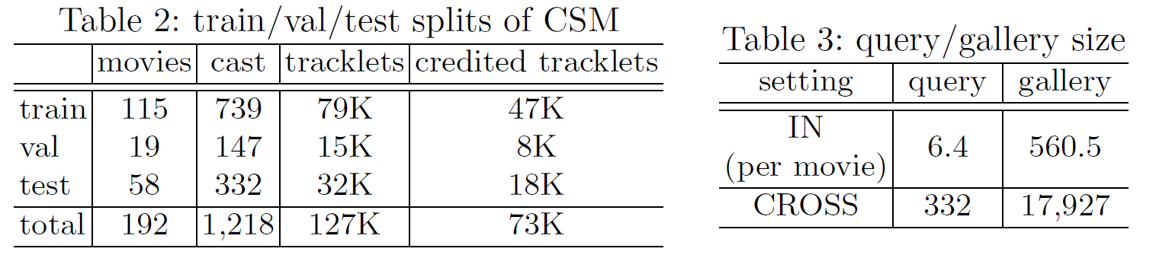
Evaluation protocol and metrics of CSM
2: Training, validation, testing no overlap
3: IN: search cast in a movie
ACROSS: search cast across all movies

Slide 44
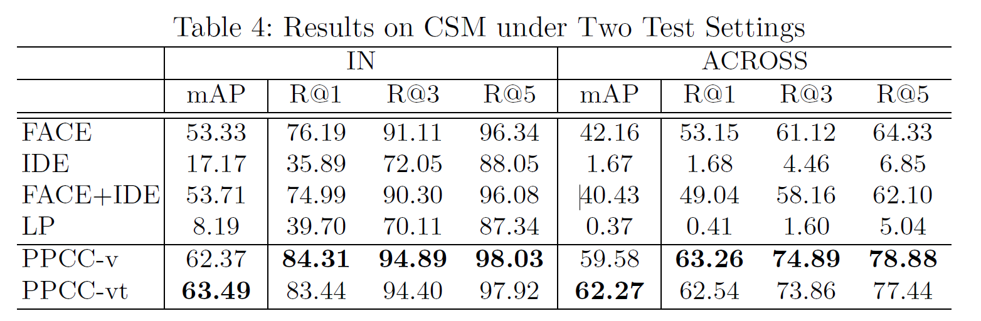
Result on CSM
The IDE descriptor is a CNN feature of the whole person instance, extracted by a Resnet-50, pre-trained on ImageNet and finetuned on CSM`s training set
FACE is the face feature, extracted by a Resnet-101, trained on MS-Celeb-1M

Slide 45
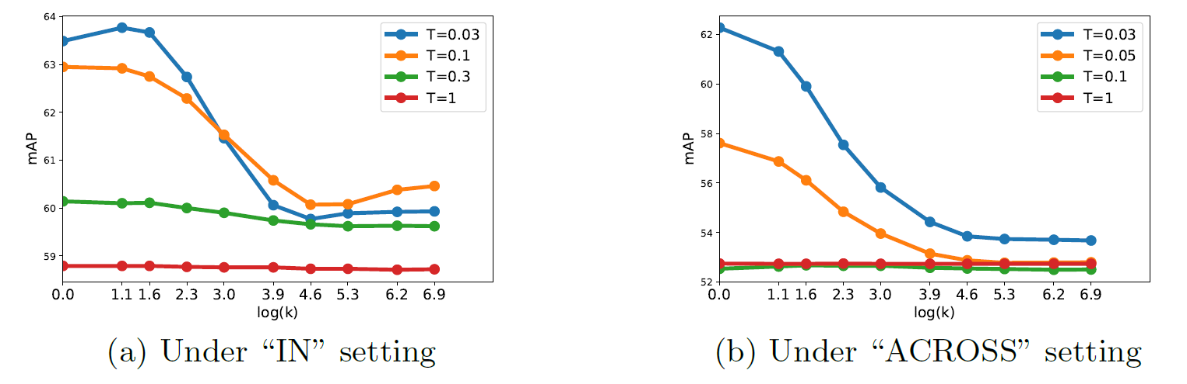
Analysis on Competitive Consensus
mAP of different settings of competitive consensus. Comparison between different temperatures(T) of softmax and different settings of k (in top-k average)

Slide 46
Analysis on Competitive Consensus

Slide 47
Analysis on Competitive Consensus
mAP of different settings of competitive consensus. Comparison between different temperatures(T) of softmax and different settings of k (in top-k average)

Slide 48
Analysis on Progressive Propagation
Two progressive updating schemes and the conventional scheme:
Step: ratio of each iteration are raised step by step(r=0.5+0.1*iter)
Threshold: freeze nodes whose max probability to a particular identity is greater than the threshold(0.5)

Slide 49
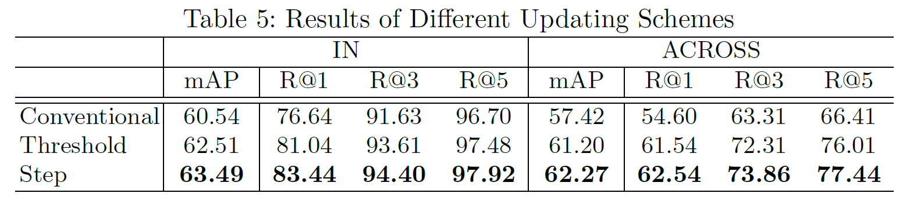
Analysis on Progressive Propagation

Slide 50
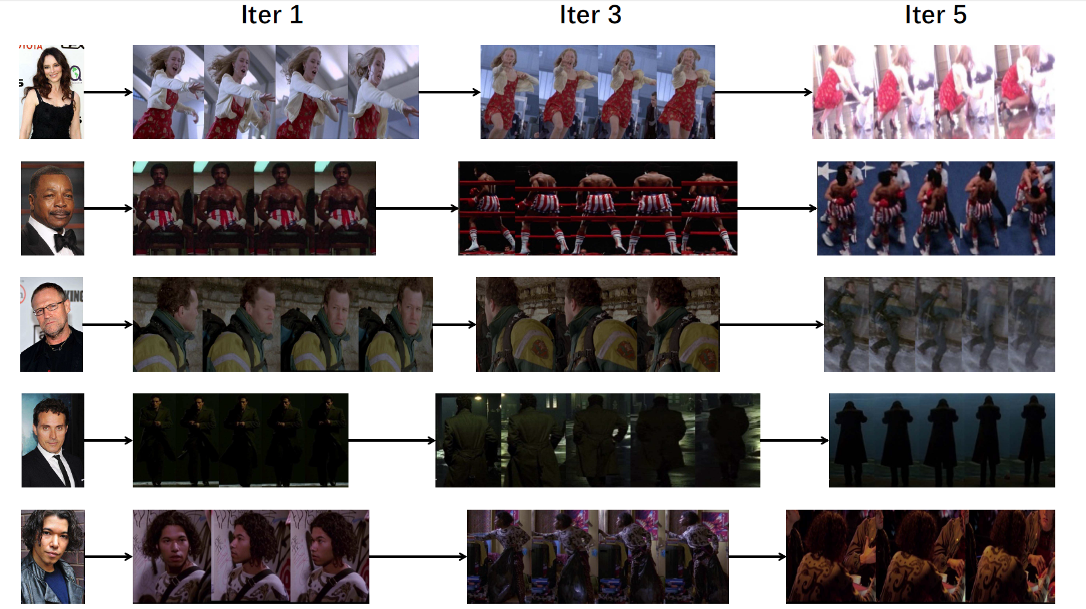
Case study

Slide 51
谢谢

